Slide 1
Natural Language Processing
Presented By
Anurag Tiwari
Assistant Professor
School of Computer Science & Engineering
VIT (BHOPAL CAMPUS)

Slide 2
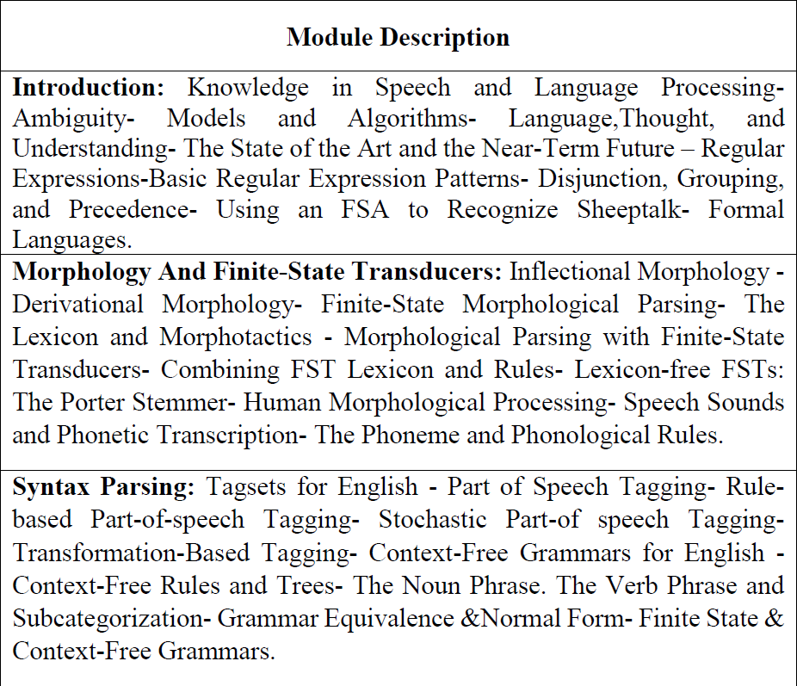
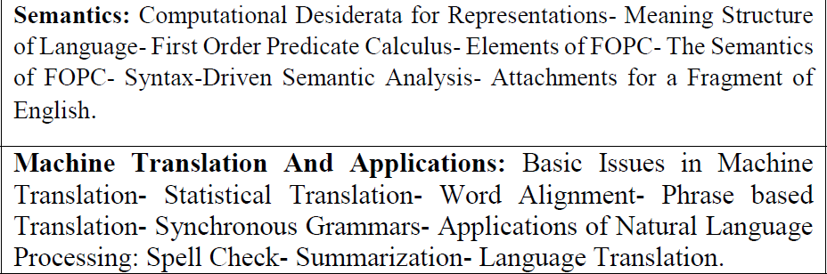
Syllabus

Slide 3
Knowledge in Speech and Language Processing
Question: What distinguishes language processing applications from other data processing systems is their
use of knowledge of language?
Response: Consider the Unix wc program, which counts the total number of bytes, words, and lines in a
text file. When used to count bytes and lines, wc is an ordinary data processing application.
However, when it is used to count the words in a file, it requires knowledge about
what it means to be a word and thus becomes a language processing system.
Sophisticated conversational agents like HAL, machine translation systems, or robust
question-answering systems require much broader and deeper knowledge of language.
HAL must be able to recognize words from an audio signal and to generate an audio signal
from a sequence of words.
These tasks of speech recognition and speech synthesis require knowledge about phonetics and
phonology: how words are pronounced in terms of sequences of sounds and how each of these
sounds is realized acoustically.

Slide 4
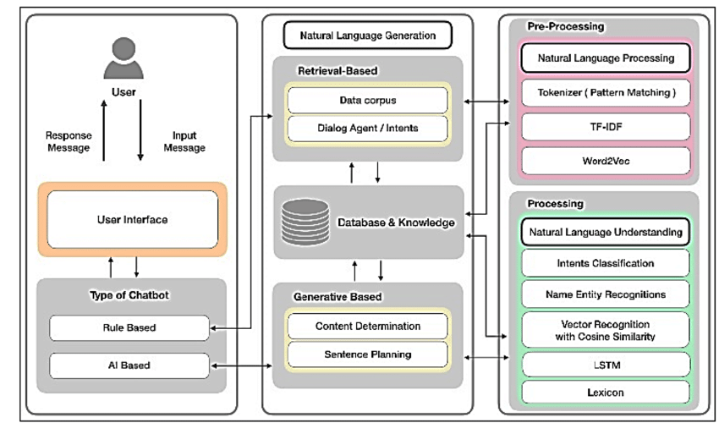
Generalized Architecture of a Conversational Agent

Slide 5
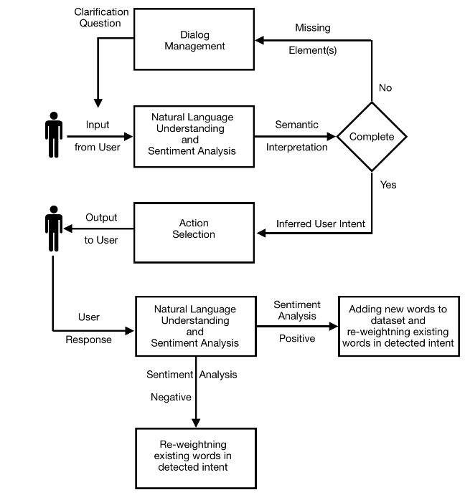
Working of a Conversational Agent

Slide 6
Natural Language Processing
Natural language processing (NLP) is a branch of artificial intelligence (AI) that enables machines to understand the human language.
Its goal is to build systems that can make sense of text and automatically perform tasks like translation, spell check, or topic classification.
Natural Language Processing (NLP) makes it possible for computers to understand the human language.

Slide 7
Natural Language Processing
Behind the scenes, NLP analyzes the grammatical structure of sentences and the individual meaning of words, then uses algorithms to extract meaning and deliver outputs.
Probably, the most popular examples of NLP in action are virtual assistants, like Google Assist, Siri, and Alexa.
NLP understands written and spoken text like “Hey Siri, where is the nearest gas station?” and transforms it into numbers, making it easy for machines to understand.

Slide 8
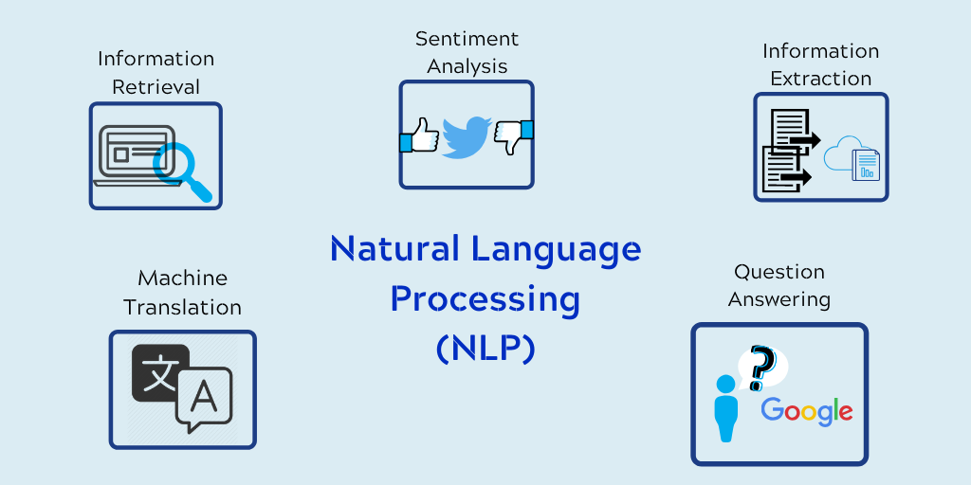
Natural Language Processing

Slide 9
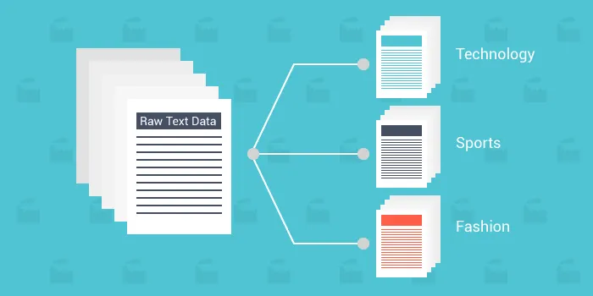
Application of Natural Language Processing
Text Classification or Categorization
Text Classification or Text Categorization is a way to perform the labeling of natural language texts into a predefined set of relevant categories.
The underlying purpose is to categorize the information from a large chunk of text data. This NLP application has enhanced the searchability of various systems.
Tagging of contents on e-commerce, news apps, blogs, and social media apps is one of its use cases.
Along with this, various organizations are using this technique to manage unstructured text.
Lionbridge.ai is one of those companies that prominently focus on providing text classification services.

Slide 10
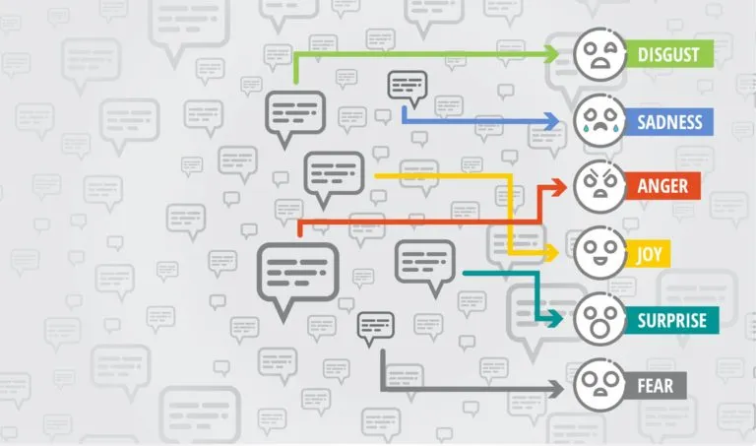
Application of Natural Language Processing
Sentiment Analysis
Sentiment Analysis is one of the most well-known applications of natural language processing that understands and classify sentiments or emotions from text data with the help of various NLP techniques.
Sentiment Analysis is generally used by companies to summarize feedback from customers about products, movies, brands, and different online movements.
It can also help in understanding people’s thoughts on their government and its policies.
Some well-known companies using Sentiment Analysis are Scale AI, Lexalytics, and Monkey Learn.

Slide 11


Application of Natural Language Processing

Slide 12
Application of Natural Language Processing
Automatic text generation
The automatic text generation application is used for generating textual data that can be used by language models to predict the occurrence of words based on the words already present in the text.
Therefore the language models are trained with such kind of data and then prediction takes place for generating text.
OpenAI has built an AI-based text generator which has gained a lot of popularity from people
Document Summarization
Text Summarization or Document Summarization is a technique through which we can automatically generate concise summaries of large pieces of text.
There are situations where we need to understand the gist of text available and this can be done efficiently through document summarization.
SummarizeBot is one of the companies that have leveraged the power of text summarization.
Agolo, an AI startup is working in this domain with support from tech giants like Google and Microsoft.

Slide 13
Application of Natural Language Processing
Speech Recognition – Virtual Smart Assistants
We, humans, have the unique ability to express our thoughts in the external world through speech. Speech recognition is one of the ways through which machines are made capable of understanding the human natural language.
Smart Virtual Assistant is the major innovation that has been made possible due to speech recognition.
Apple’s Siri, Google’s Voice Assistant, and Amazon’s Alexa are some of the well-known voice assistants that are able to understand our voice commands for daily tasks with ease.
Nuance is a well-known company that has built a virtual assistant named Nina. Its performance has been commendable and is attracting more companies for availing of the services.

Slide 14
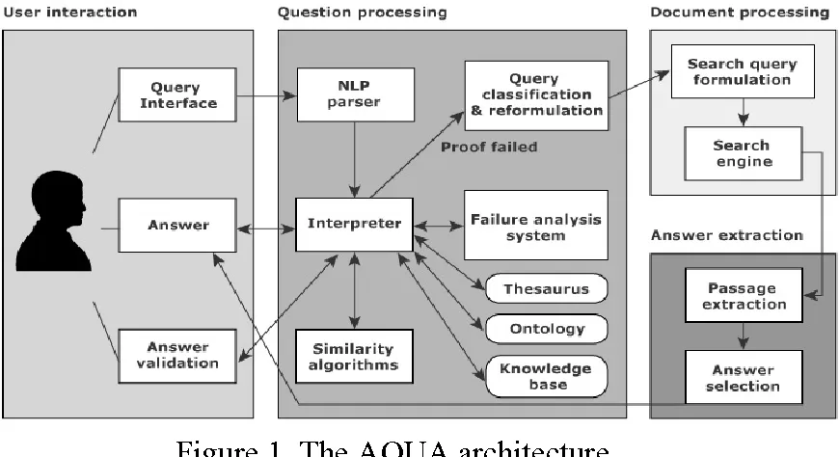
Application of Natural Language Processing
Question Answering System
The question answering system is an information retrieval tool that leverages Natural language processing.
These kinds of QnA systems help in answering questions put up by humans in their natural language. By fusing multiple applications of NLP, a competent QnA system is built.
The customer support system is highly benefitted with the advent of question answering systems. Customers can look for the answers to their regular queries from such QnA systems

Slide 15
Natural Language Processing Techniques
Natural Language Processing (NLP) applies two techniques to help computers understand text: syntactic analysis and semantic analysis.
Syntactic Analysis
Syntactic analysis ‒ or parsing ‒ analyzes text using basic grammar rules to identify sentence structure, how words are organized, and how words relate to each other.
Some of its main sub-tasks include:

Slide 16
Natural Language Processing Techniques
Tokenization consists of breaking up a text into smaller parts called tokens (which can be sentences or words) to make text easier to handle.
Part of speech tagging (PoS tagging) labels tokens as verb, adverb, adjective, noun, etc. This helps infer the meaning of a word (for example, the word “book” means different things if used as a verb or a noun).
Lemmatization & stemming consist of reducing inflected words to their base form to make them easier to analyze.
Stop-word removal removes frequently occurring words that don’t add any semantic value, such as I, they, have, like, yours, etc.

Slide 17
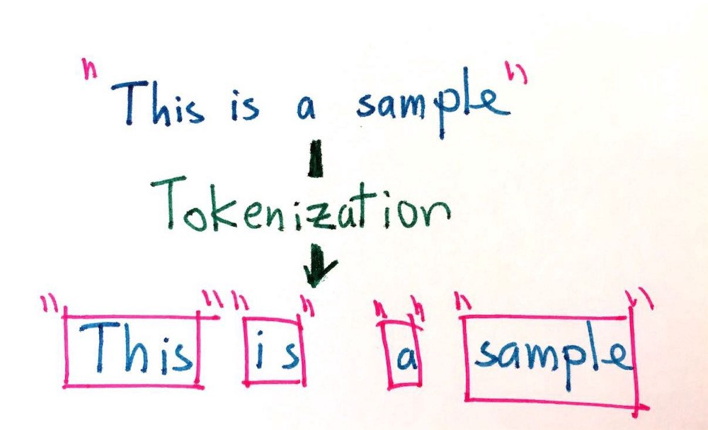
Natural Language Processing Techniques
Tokenization is the process of breaking down the given text in natural language processing into the smallest unit in a sentence called a token.
Punctuation marks, words, and numbers can be considered tokens.

Slide 18
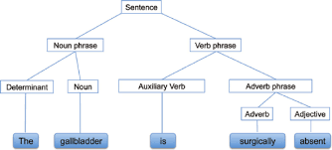
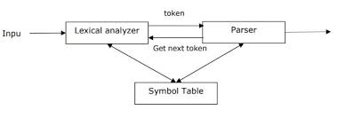
Natural Language Processing Techniques

Slide 19
Ambiguity and Uncertainty in NLP
Ambiguity, generally used in natural language processing, can be referred as the ability of being understood in more than one way.
In simple terms, we can say that ambiguity is the capability of being understood in more than one way.
Natural language is very ambiguous. NLP has the following types of ambiguities −

Slide 20
Ambiguity and Uncertainty in NLP
Type of Ambiguity | Description
Lexical Ambiguity | The ambiguity of a single word is called lexical ambiguity. For example, treating the word silver as a noun, an adjective, or a verb.
Syntactic Ambiguity | This kind of ambiguity occurs when a sentence is parsed in different ways. For example, the sentence “The man saw the girl with the telescope”. It is ambiguous whether the man saw the girl carrying a telescope or he saw her through his telescope.
Semantic Ambiguity | This kind of ambiguity occurs when the meaning of the words themselves can be misinterpreted. In other words, semantic ambiguity happens when a sentence contains an ambiguous word or phrase. For example, the sentence “The car hit the pole while it was moving” is having semantic ambiguity because the interpretations can be “The car, while moving, hit the pole” and “The car hit the pole while the pole was moving”.

Slide 21
Ambiguity and Uncertainty in NLP
Type of Ambiguity | Description
Anaphoric Ambiguity | This kind of ambiguity arises due to the use of anaphora entities in discourse. For example, the horse ran up the hill. It was very steep. It soon got tired. Here, the anaphoric reference of “it” in two situations cause ambiguity.
Pragmatic ambiguity | Such kind of ambiguity refers to the situation where the context of a phrase gives it multiple interpretations. In simple words, we can say that pragmatic ambiguity arises when the statement is not specific. For example, the sentence “I like you too” can have multiple interpretations like I like you (just like you like me), I like you (just like someone else dose).

Slide 22
NLP Functions
Among the tasks that Natural Language Processing solves the most important ones are:
Machine translation is the first classic task assigned to the developers of NLP-technologies (it is necessary to note that it is not yet solved at the necessary level of quality for today).
Grammar and spell checking – as a conclusion of the first task.
Text classification – definitions of text semantics for further processing (one of the most popular tasks to date).
Summarization – the text generalization to a simplified version form (re-interpretation the content of the texts).
Text generation – one of the tasks that are used to build AI-systems;
Topic modeling – technique for extracting hidden topics from large text volumes.

Slide 23
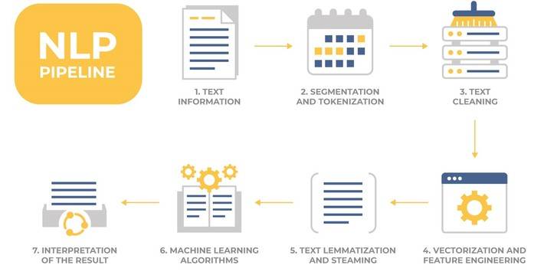
NLP Functioning

Slide 24
NLP Functioning (block diagram explanation)
Enter the text (or sound converted to text)
Segmentation of text into components (segmentation and tokenization).
Text Cleaning (filtering from “garbage”) – removal of unnecessary elements.
Text Vectorization and Feature engineering.
Lemmatization and Steaming – reducing inflections for words.
Using Machine Learning algorithms and methods for training models.
Interpretation of the result

Slide 25
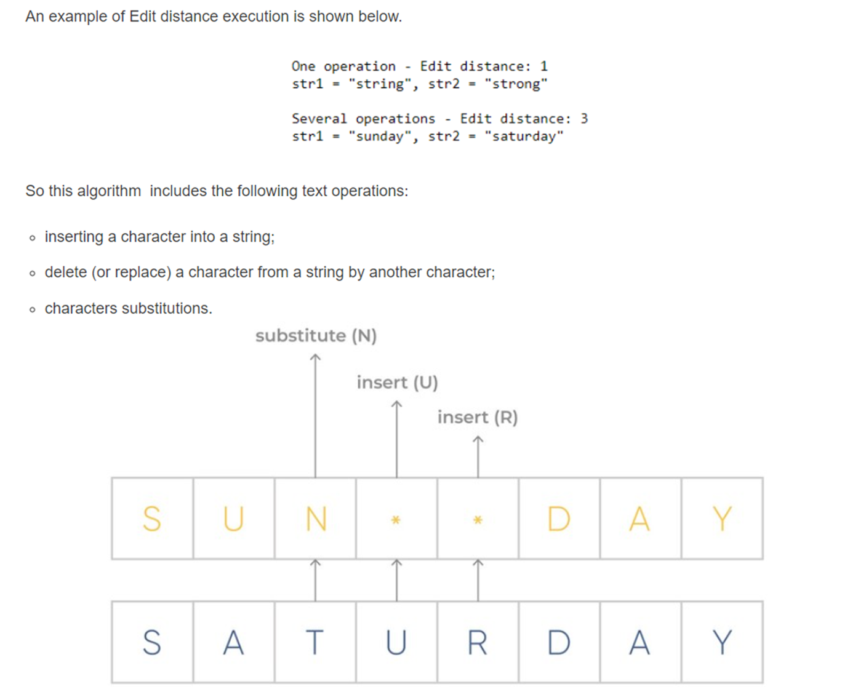
Metrices used in NLP
Metric | Function
Edit Distance | One of the simple and at the same time popularly usable metrics is Edit distance (sometimes is known as Levenshtein distance) – an algorithm for estimating the similarity of two string values (word, words form, words composition), by comparing the minimum number of operations to convert one value into another.

Slide 26
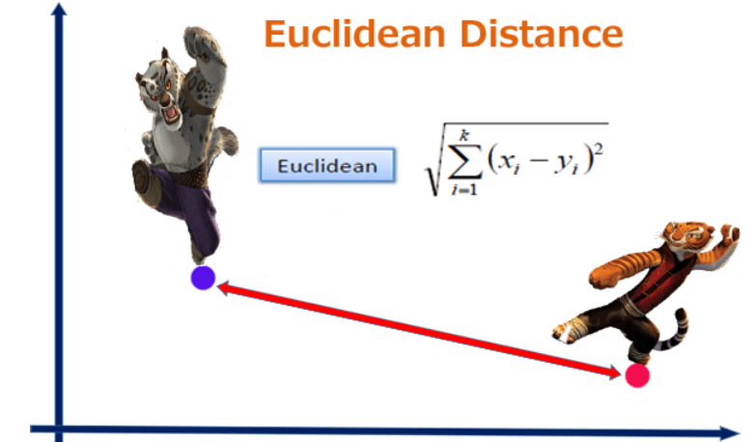
Metrices used in NLP
Metric | Function
Euclidean Distance | Euclidean distance (often called L2 norm) is the most intuitive of the metrics. Comparing the shortest distance among two objects. Score means the distance between two objects. If it is 0, it means that both objects are identical.

Slide 27
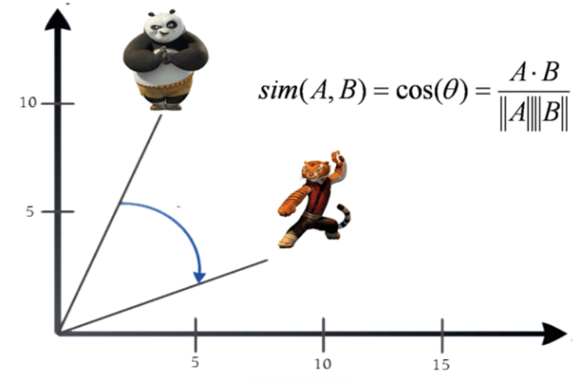
Metrices used in NLP
Metric | Function
Cosine Similarity | Determine the angle between two objects is the calculation method to the find similarity. The range of score is 0 to 1. If score is 1, it means that they are same in orientation (not magnitude).

Slide 28
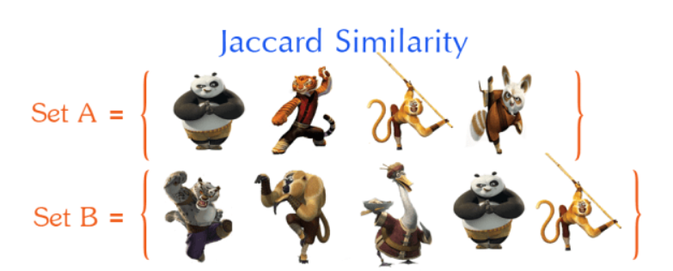
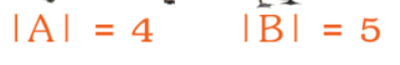
Metrices used in NLP
Metric | Function
Jaccard Index | The measurement is refer to number of common words over all words. More commons mean both objects should be similarity.
Jaccard Similarity = (Intersection of A and B) / (Union of A and B)
The range is 0 to 1. If score is 1, it means that they are identical. There is no any common word between the first sentence and the last sentence so the score is 0. The following example shows score when comparing the first sentence.

Slide 29
Popular models in NLP
Keyword Extraction
Keywords Extraction is one of the most important tasks in Natural Language Processing, and it is responsible for determining various methods for extracting a significant number of words and phrases from a collection of texts.
All of this is done to summarize and assist in the relevant and well-organized organization, storage, search, and retrieval of content.
There are numerous keyword extraction algorithms available, each of which employs a unique set of fundamental and theoretical methods to this type of problem.
There are various types of NLP algorithms, some of which extract only words and others which extract both words and phrases.
There are also NLP algorithms that extract keywords based on the complete content of the texts.

Slide 30
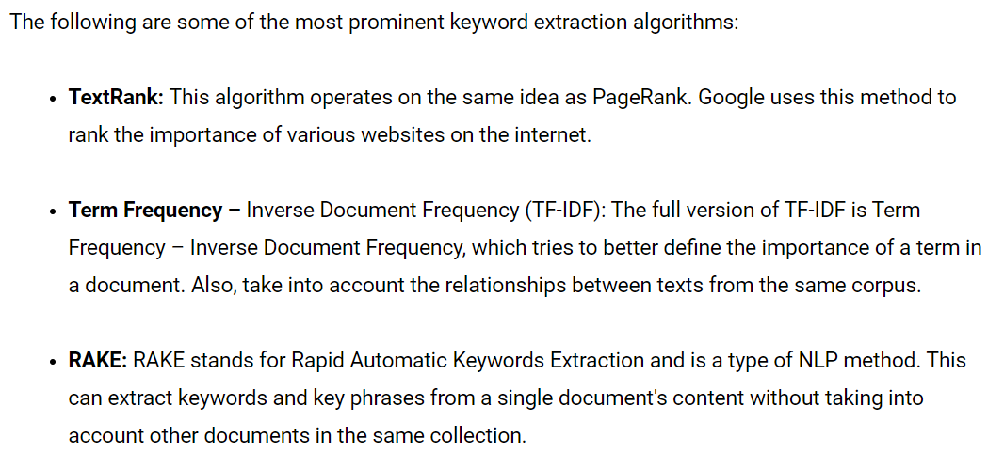
Popular models in NLP

Slide 31
Popular models in NLP

Slide 32
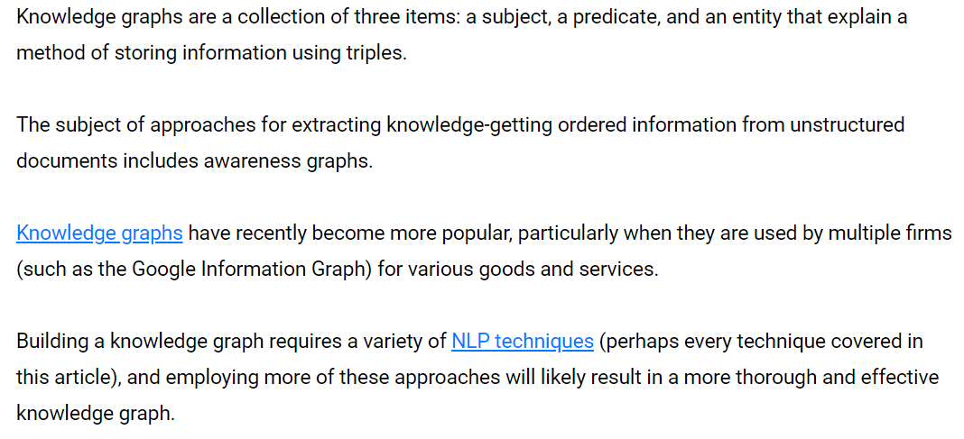
Popular models in NLP
Knowledge Graphs

Slide 33
Popular models in NLP
Knowledge Graphs

Slide 34
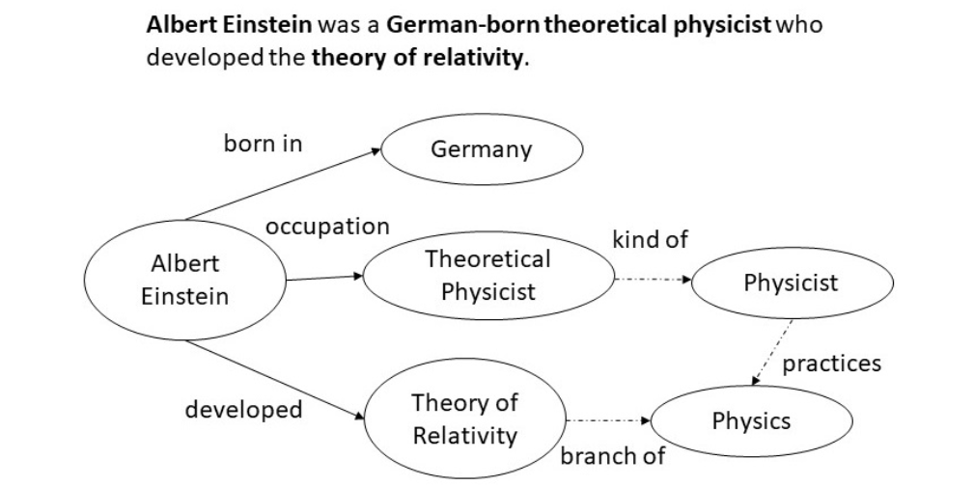
Popular models in NLP
Knowledge Graphs

Slide 35
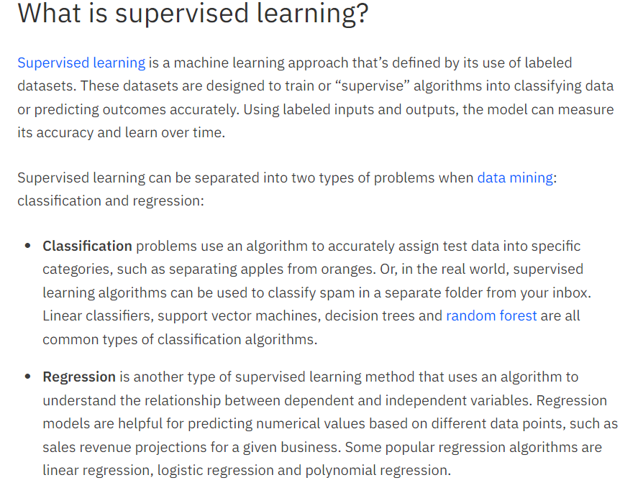
Learning models in NLP
Within artificial intelligence (AI) and machine learning, there are two basic approaches: supervised learning and unsupervised learning. The main difference is one uses labeled data to help predict outcomes, while the other does not.

Slide 36
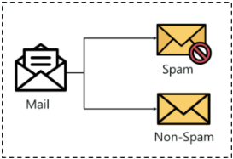
Classification in NLP
Classification is a process of categorizing a given set of data into classes, It can be performed on both structured or unstructured data.
The process starts with predicting the class of given data points. The classes are often referred to as target, label or categories.
The classification predictive modeling is the task of approximating the mapping function from input variables to discrete output variables.
The main goal is to identify which class/category the new data will fall into.
Let us try to understand this with a simple example.
Heart disease detection can be identified as a classification problem, this is a binary classification since there can be only two classes i.e has heart disease or does not have heart disease. The classifier, in this case, needs training data to understand how the given input variables are related to the class. And once the classifier is trained accurately, it can be used to detect whether heart disease is there or not for a particular patient.

Slide 37
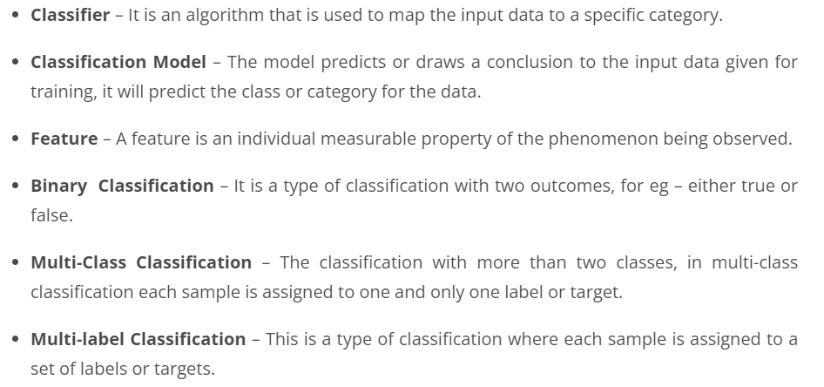
Classification in NLP
Since classification is a type of supervised learning, even the targets are also provided with the input data. Let us get familiar with the classification in machine learning terminologies.
Classification Terminologies in Machine Learning

Slide 38
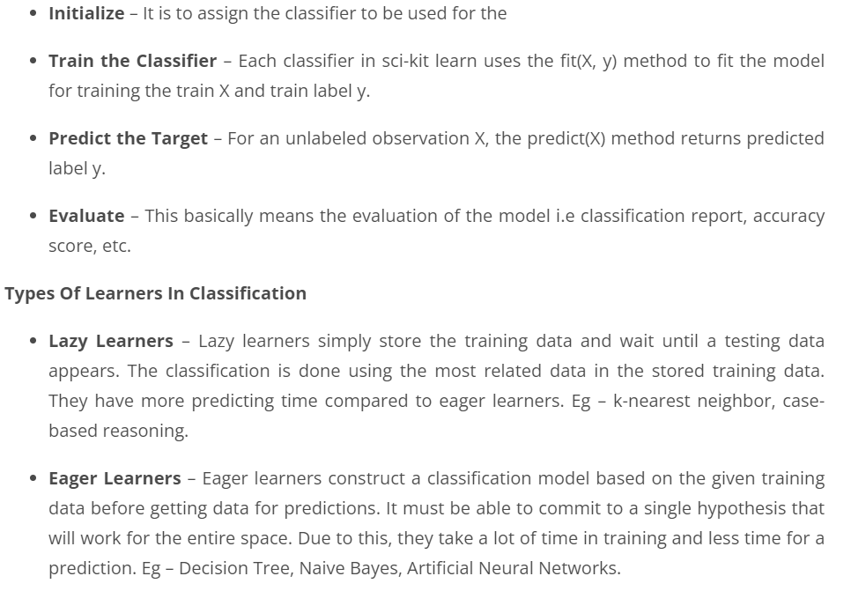
Classification in NLP

Slide 39
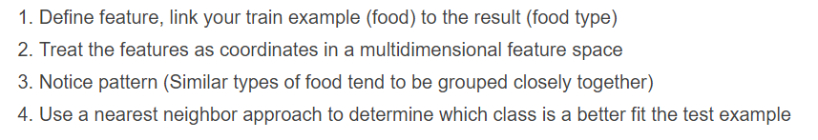
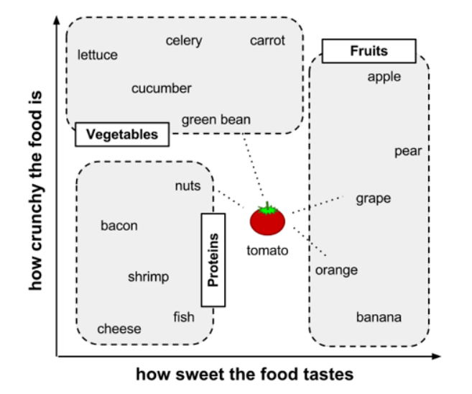
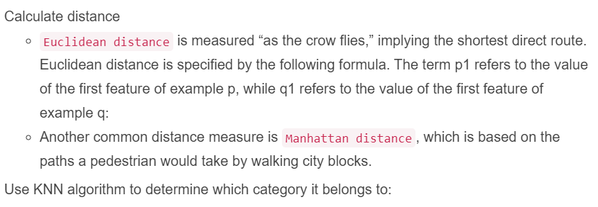
K-Nearest Neighbor classifier
Rules

Slide 40
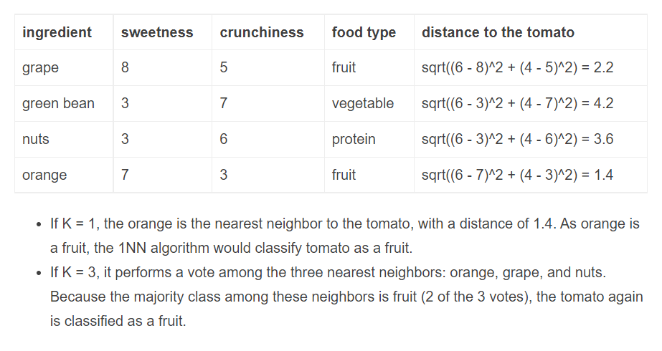
K-Nearest Neighbor classifier

Slide 41
Clustering
Clustering is the most popular technique in unsupervised learning where data is grouped based on the similarity of the data-points.
The basic principle behind cluster is the assignment of a given set of observations into subgroups or clusters such that observations present in the same cluster possess a degree of similarity.
It is the implementation of the human cognitive ability to discern objects based on their nature. For example, when you go out for grocery shopping, you easily distinguish between apples and oranges in a given set containing both of them.
You distinguish these two objects based on their color, texture and other sensory information that is processed by your brain.
Clustering is an emulation of this process so that machines are able to distinguish between different objects.

Slide 42
Clustering
It is a method of unsupervised learning since there is no external label attached to the object.
The machine has to learn the features and patterns all by itself without any given input-output mapping.
The algorithm is able to extract inferences from the nature of data objects and then create distinct classes to group them appropriately

Slide 43
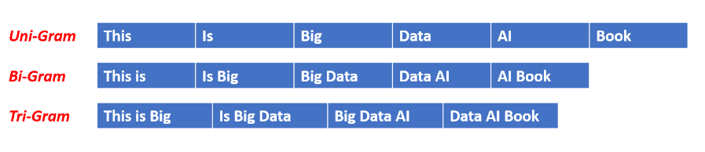
Language Modelling (LM)
Language models are one of the most important parts of Natural Language Processing. In this shot, We will discuss the simplest of the language models.
N-Gram Model where ‘N’ can be any positive number.
In ‘N-Gram Model’, sequence of N-1 words are given and the N-gram model predicts the most probable word that might follow this sequence.
It's a probabilistic model that's trained on a corpus of text. Such a model is useful in many NLP applications including speech recognition, machine translation and predictive text input.

Slide 44
Language Modelling (LM)
An N-gram model is one type of a Language Model (LM), which is about finding the probability distribution over word sequences.
Consider two sentences: "There was heavy rain" vs. "There was heavy flood". From experience, we know that the former sentence sounds better. An N-gram model will tell us that "heavy rain" occurs much more often than "heavy flood" in the training corpus. Thus, the first sentence is more probable and will be selected by the model.
A model that simply relies on how often a word occurs without looking at previous words is called unigram. If a model considers only the previous word to predict the current word, then it's called bigram. If two previous words are considered, then it's a trigram model.
An n-gram model for the above example would calculate the following probability:

Slide 45
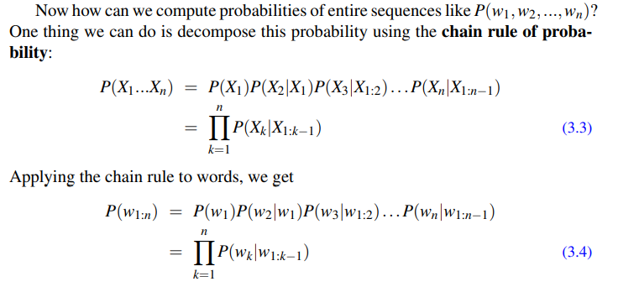
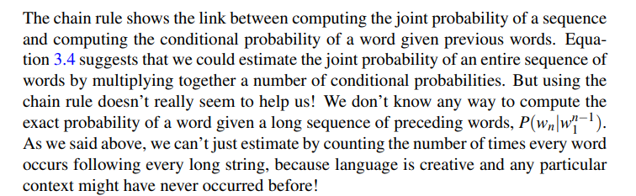
Language Modelling (Chain rule of probability)

Slide 46
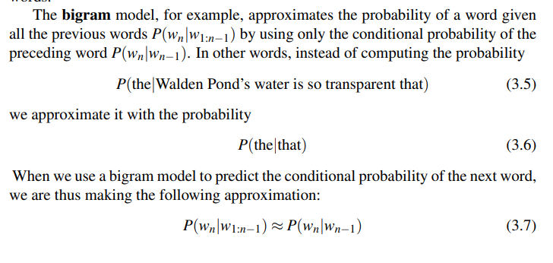
Language Modelling (Bigram)
The assumption that the probability of a word depends only on the previous word is Markov called a Markov assumption.
Markov models are the class of probabilistic models that assume we can predict the probability of some future unit without looking too far into the past.
We can generalize the bigram (which looks one word into the past) n-gram to the trigram (which looks two words into the past) and thus to the n-gram (which looks n−1 words into the past).

Slide 47
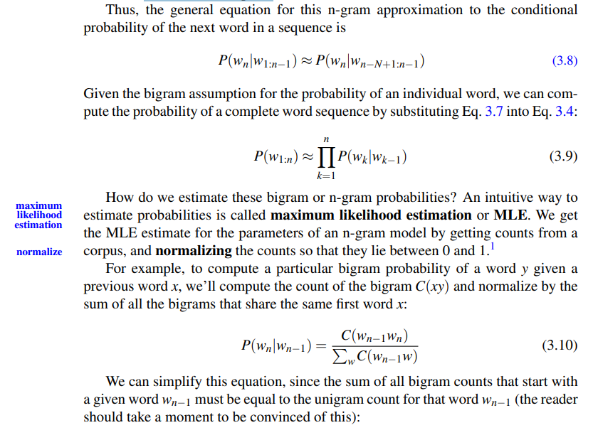
Language Modelling (Bigram)

Slide 48
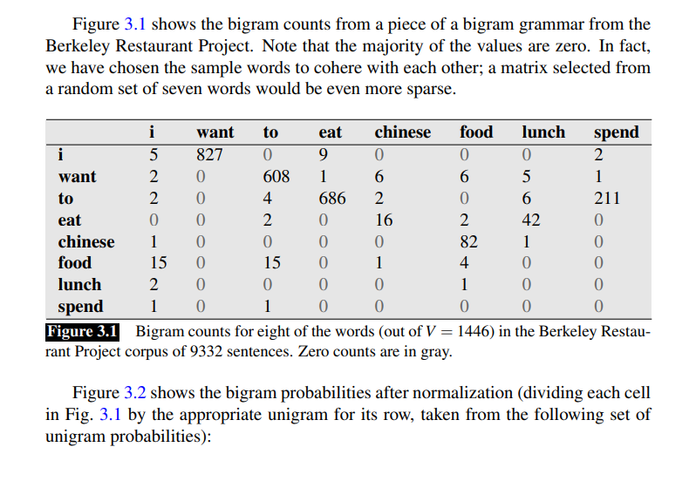
Language Modelling (Bigram)

Slide 49
Language Modelling (Bigram)

Slide 50
Perplexity
In information theory, perplexity is a measurement of how well a probability distribution or probability model predicts a sample.
It may be used to compare probability models. A low perplexity indicates the probability distribution is good at predicting the sample.

Slide 51
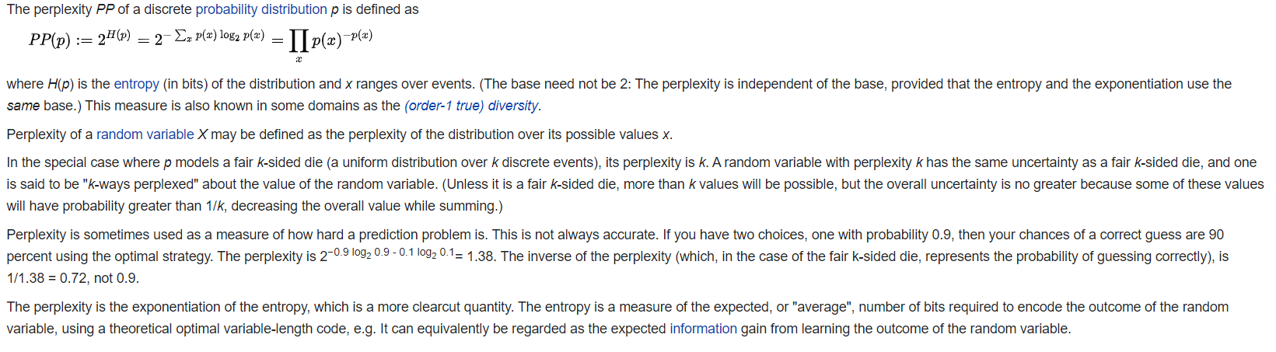
Perplexity of a probability distribution

Slide 52
Perplexity per word
Suppose we have trained a small language model over an English corpus. The model is only able to predict the probability of the next word in the sentence from a small subset of six words: “a”, “the”, “red”, “fox”, “dog”, and “.”.
Let’s compute the probability of the sentence W, which is “a red fox.”.
The probability of a generic sentence W, made of the words w1, w2, up to wn, can be expressed as the following:
P(W) = P(w1, w2, …, wn)
Using our specific sentence W, the probability can be extended as the following:
P(“a red fox.”) =
P(“a”) * P(“red” | “a”) * P(“fox” | “a red”) * P(“.” | “a red fox”)
Suppose these are the probabilities assigned by our language model to a generic first word in a sentence:

Slide 53
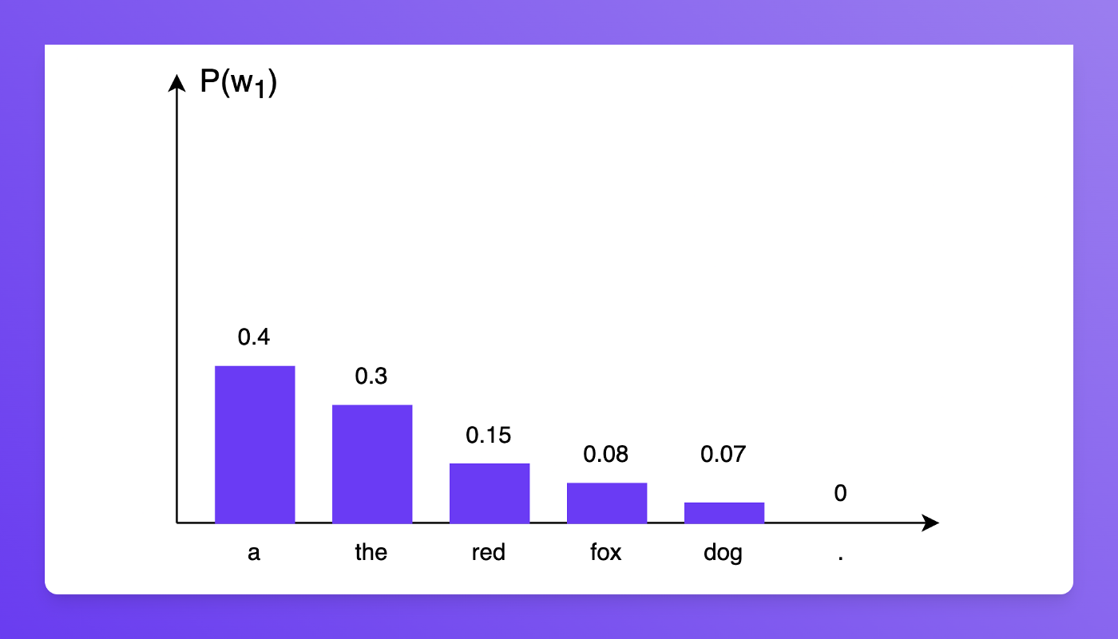
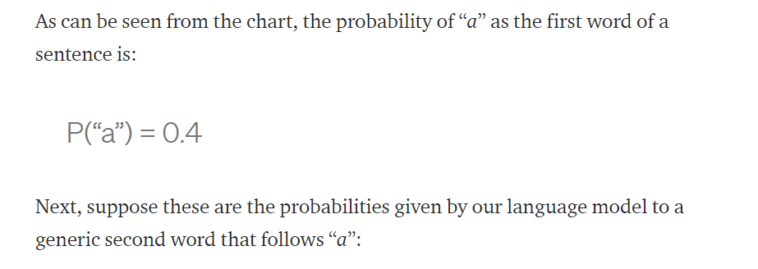
Perplexity per word

Slide 54
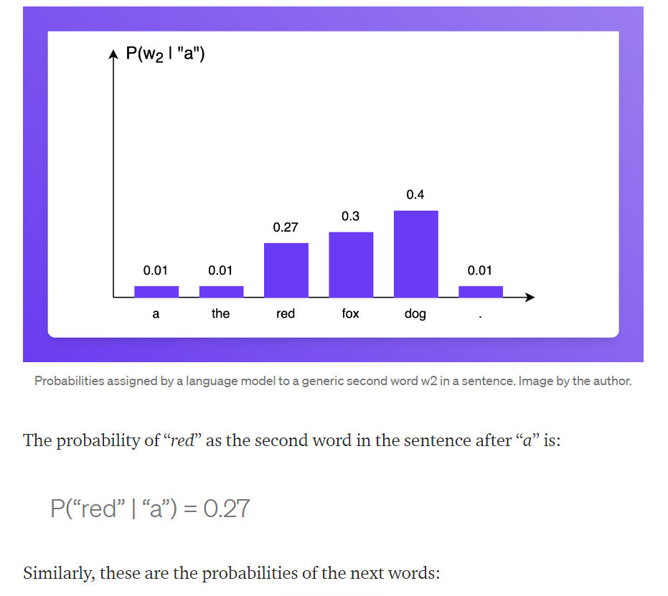
Perplexity per word

Slide 55
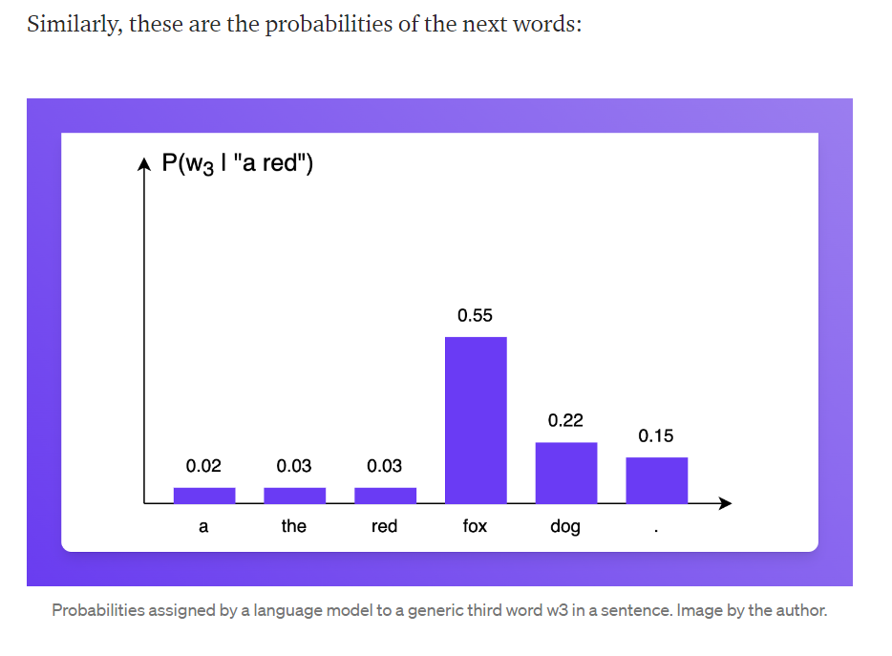
Perplexity per word

Slide 56
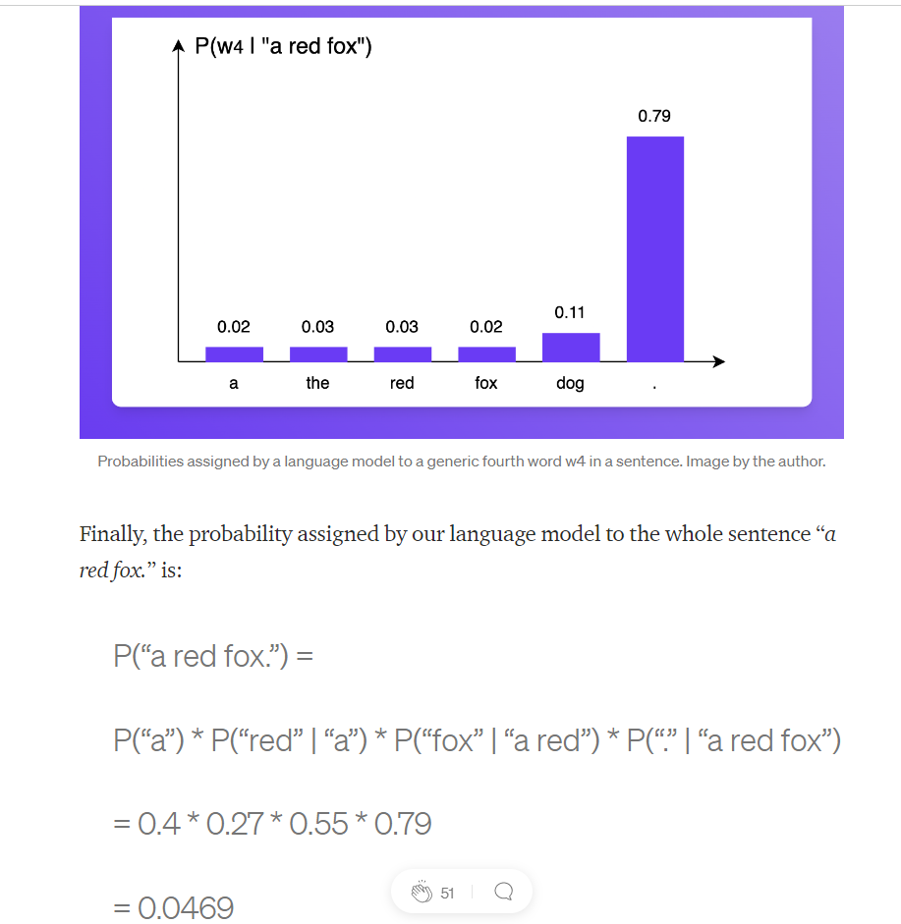
Perplexity per word

Slide 57
Perplexity per word
It would be nice to compare the probabilities assigned to different sentences to see which sentences are better predicted by the language model.
However, since the probability of a sentence is obtained from a product of probabilities, the longer is the sentence the lower will be its probability (since it’s a product of factors with values smaller than one).
We should find a way of measuring these sentence probabilities, without the influence of the sentence length.
This can be done by normalizing the sentence probability by the number of words in the sentence.
Since the probability of a sentence is obtained by multiplying many factors, we can average them using the geometric mean.

Slide 58
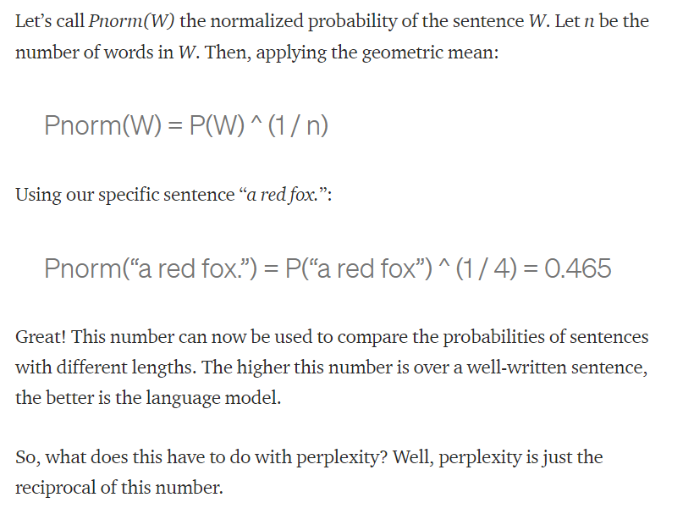
Perplexity per word

Slide 59
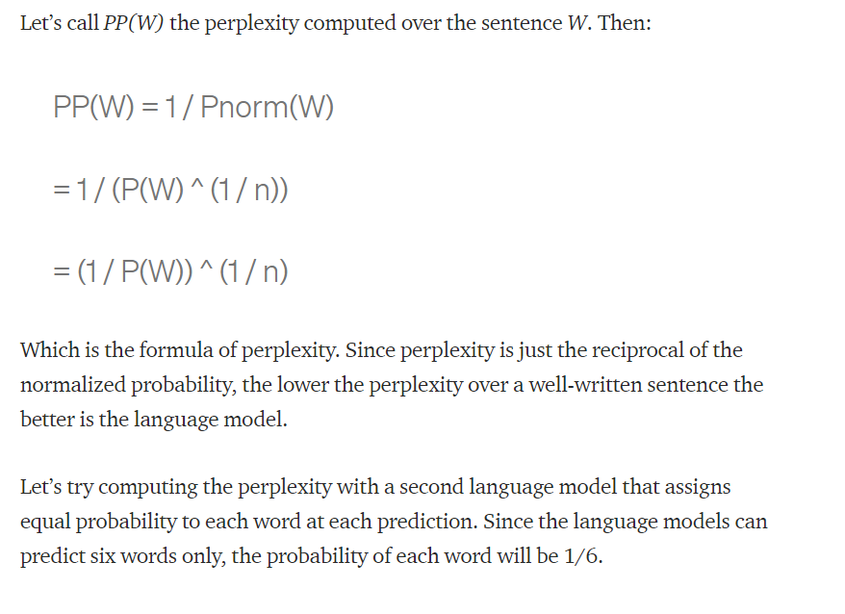
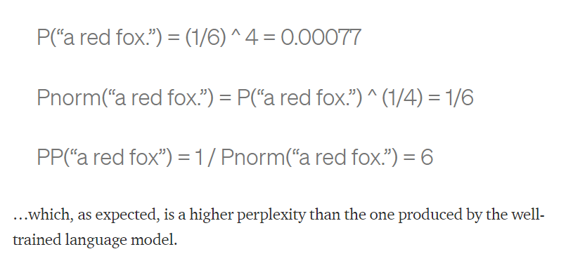
Perplexity per word

Slide 60
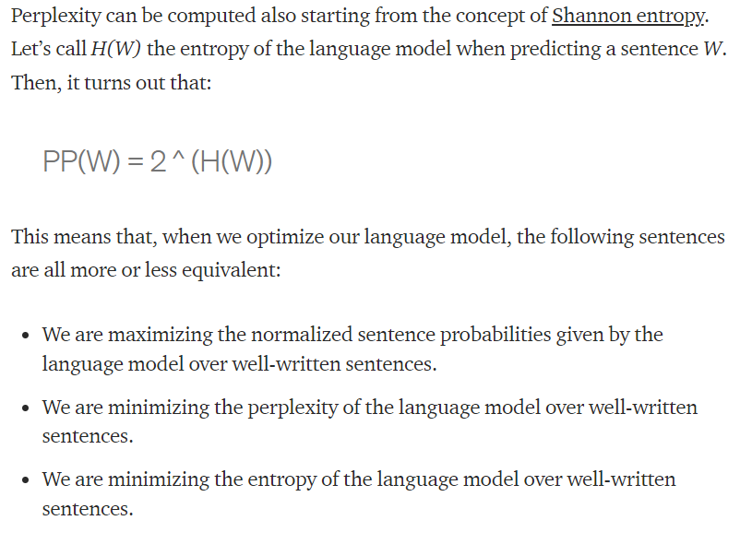
Perplexity in terms of Entropy

Slide 61
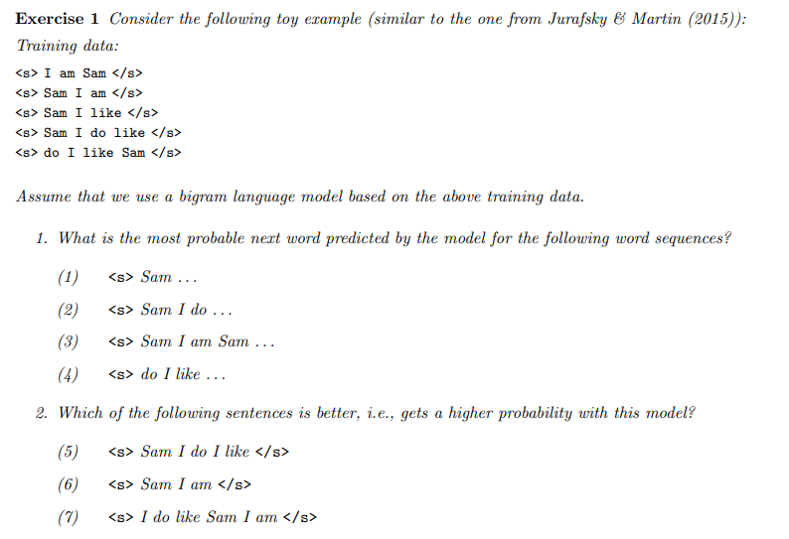
Exercise for Students

Slide 62
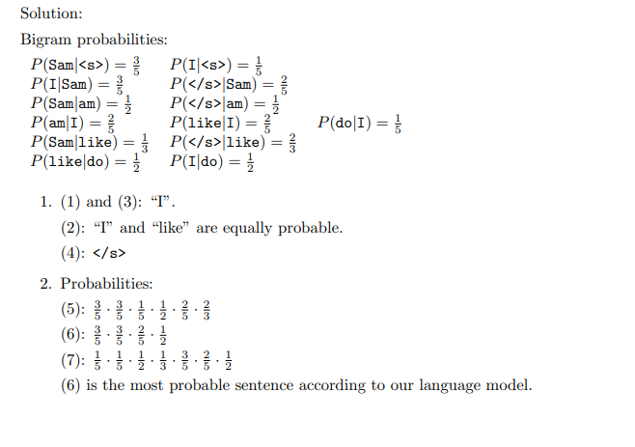
Solutions

Slide 63
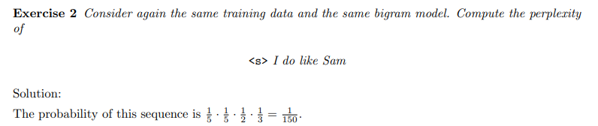
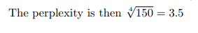
Exercise 2

Slide 64
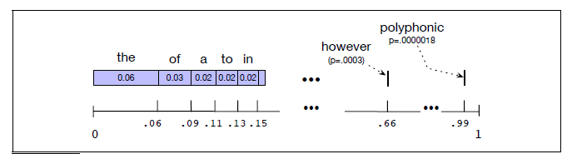
Sampling sentences from a language model
Sampling from a distribution means to choose random points according to their likelihood.
Thus sampling from a language model—which represents a distribution over sentences—means to generate some sentences, choosing each sentence according to its likelihood as defined by the model.
Thus we are more likely to generate sentences that the model thinks have a high probability and less
likely to generate sentences that the model thinks have a low probability.
It’s simplest to visualize how this works for the unigram case.
Imagine all the words of the English language covering the probability space between 0 and 1, each word covering an interval proportional to its frequency.

Slide 65
Unknown Words Handling in Prediction
Sometimes we have a language task in which this can’t happen because we know all the words that can occur.
In such a closed vocabulary system the test set can only contain words from this lexicon, and there will be no unknown words.
This is a reasonable assumption in some domains, such as speech recognition or machine translation, where we have a pronunciation dictionary or a phrase table that are fixed in advance, and so the language model can only use the words in that dictionary or phrase table.
In other cases we have to deal with words we haven’t seen before, which we’ll call unknown words, or out of vocabulary (OOV) words.
The percentage of OOV words that appear in the test set is called the OOV rate.
An open vocabulary system is one in which we model these potential unknown words in the test set by adding a pseudo-word called <UNK>.

Slide 66
Smoothing
What do we do with words that are in our vocabulary (they are not unknown words) but appear in a test set in an unseen context (for example they appear after a word they never appeared after in training)?
To keep a language model from assigning zero probability to these unseen events, we’ll have to shave off a bit of probability mass from some more frequent events and give it to the events we’ve never seen.
This modification is called smoothing or discounting.
We’ll introduce a variety of ways to do smoothing: Laplace (add-one) smoothing, add-k smoothing, stupid backoff, and Kneser-Ney smoothing.

Slide 67
Laplace Smoothing
The simplest way to do smoothing is to add one to all the n-gram counts, before we normalize them into probabilities.
All the counts that used to be zero will now have a count of 1, the counts of 1 will be 2, and so on. This algorithm is called Laplace smoothing.
Laplace smoothing does not perform well enough to be used smoothing in modern n-gram models, but it usefully introduces many of the concepts that we see in other smoothing algorithms, gives a useful baseline, and is also a practical smoothing algorithm for other tasks like text classification.
Let’s start with the application of Laplace smoothing to unigram probabilities.
Recall that the unsmoothed maximum likelihood estimate of the unigram probability of the word wi is its count ci normalized by the total number of word tokens N:

Slide 68
Laplace Smoothing Example
Let’s take an example of text classification where the task is to classify whether the review Is positive or negative.
We build a likelihood table based on the training data. While querying a review, we use the Likelihood table values, but what if a word in a review was not present in the training dataset?
Query review = w1 w2 w3 w’
We have four words in our query review, and let’s assume only w1, w2, and w3 are present in training data.
So, we will have a likelihood for those words. To calculate whether the review is positive or negative, we compare P(positive|review) and P(negative|review).

Slide 69

Laplace Smoothing Example
In the likelihood table, we have P(w1|positive), P(w2|Positive), P(w3|Positive), and P(positive). Oh, wait, but where is P(w’|positive)?
If the word is absent in the training dataset, then we don’t have its likelihood. What should we do?

Slide 70

Laplace Smoothing Example

Slide 71

Laplace Smoothing Example

Slide 72

Laplace Smoothing Example

Slide 73
Add-k smoothing

Slide 74

Laplace Smoothing

Slide 75

Language Modelling (LM)

